Slide 1










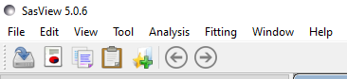
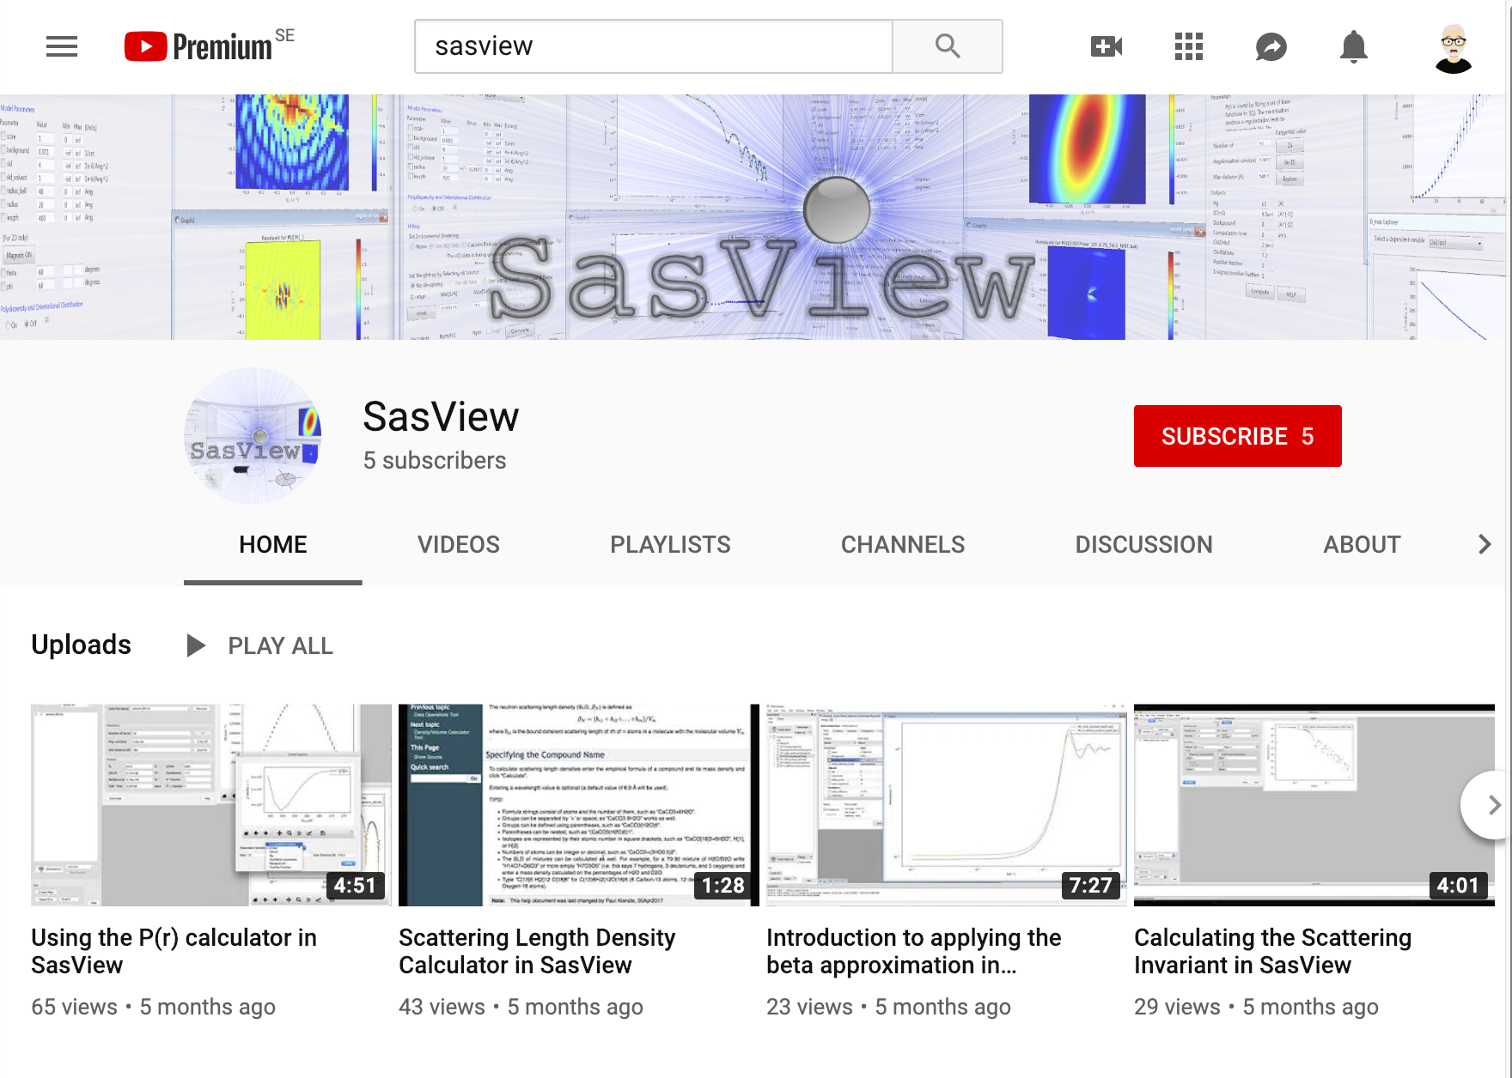

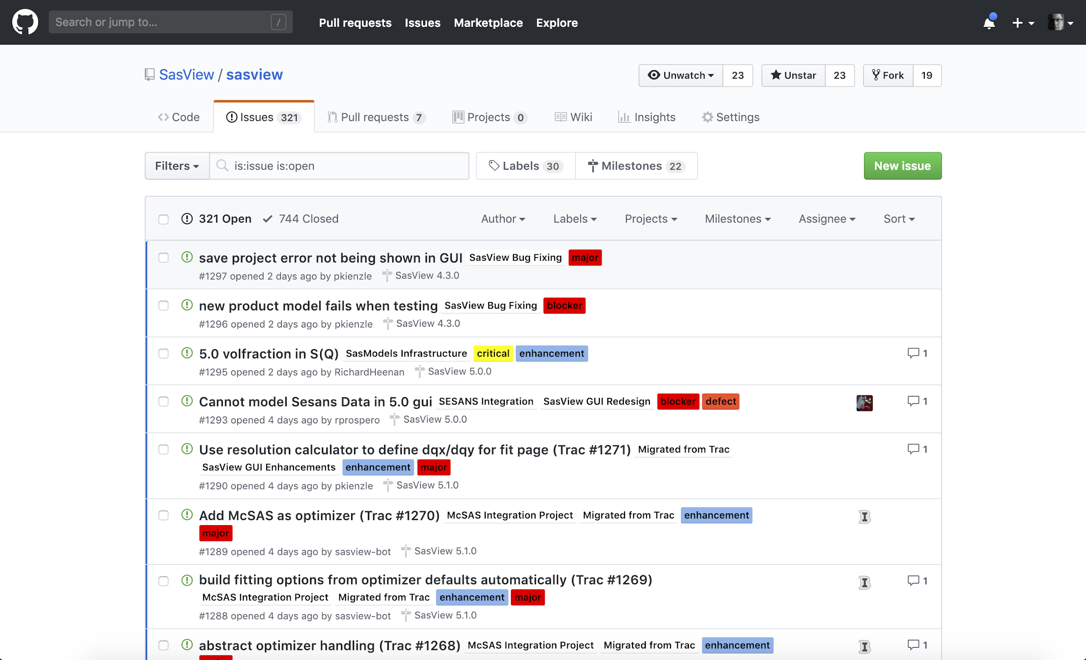
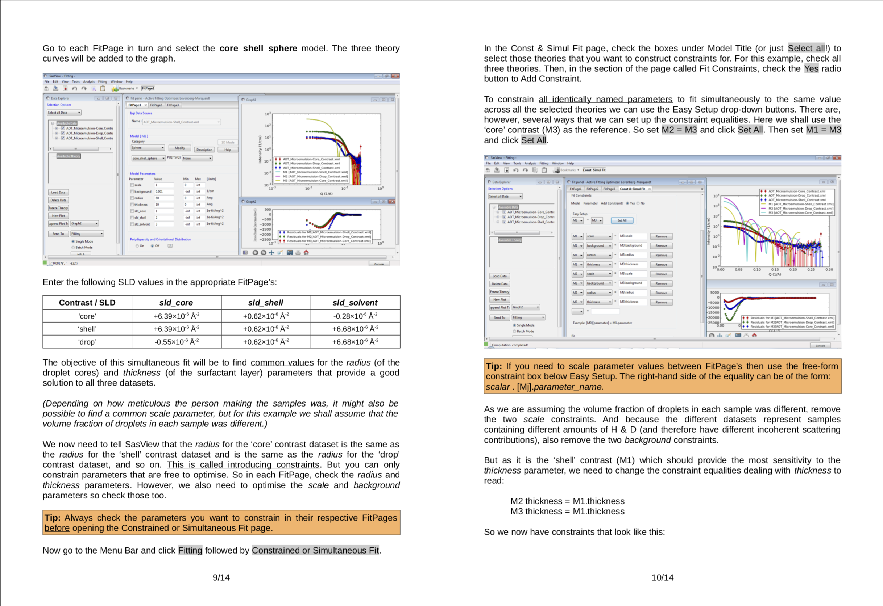
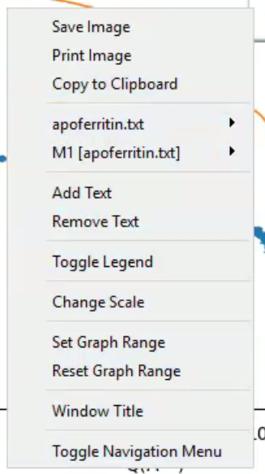
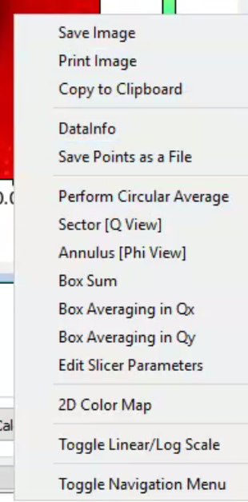
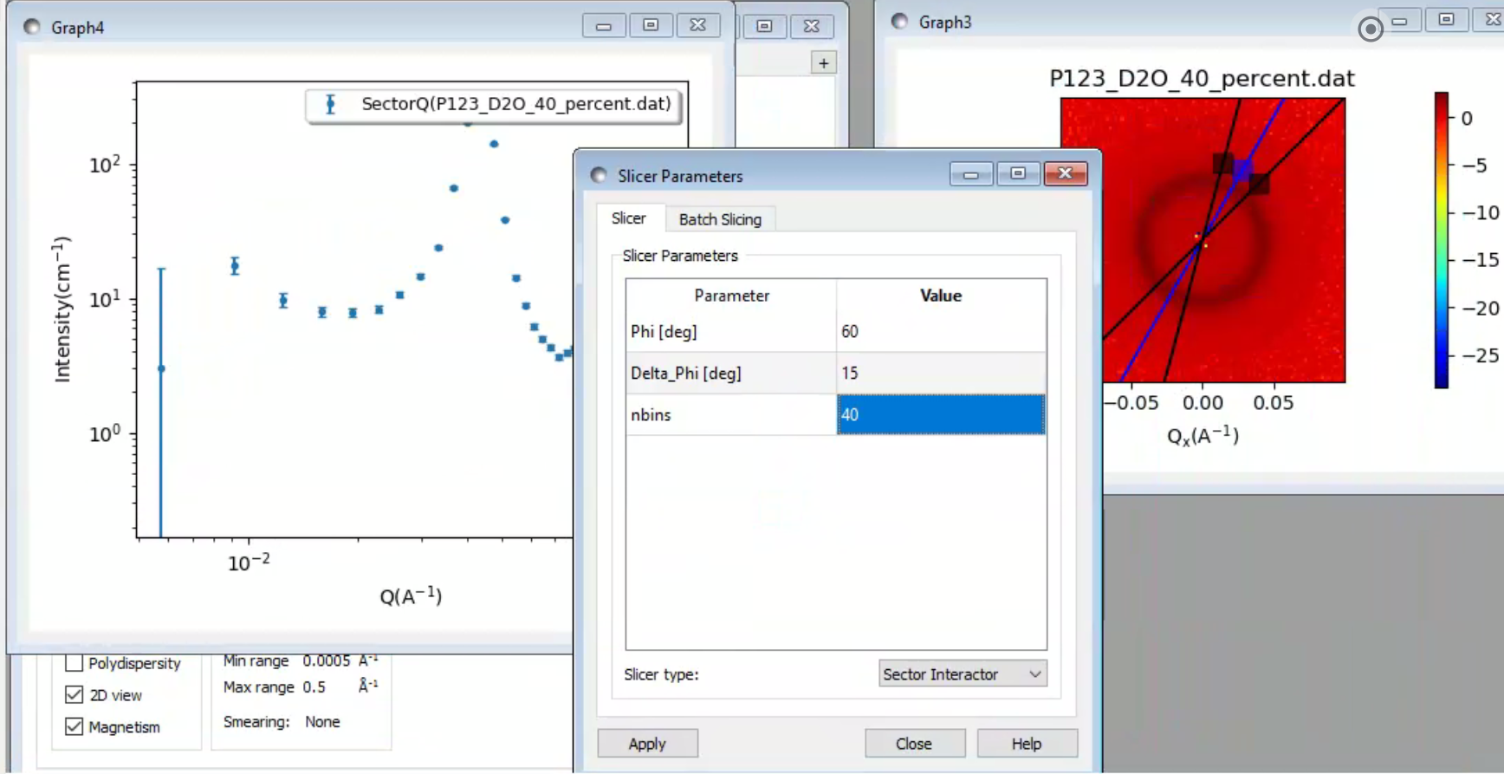
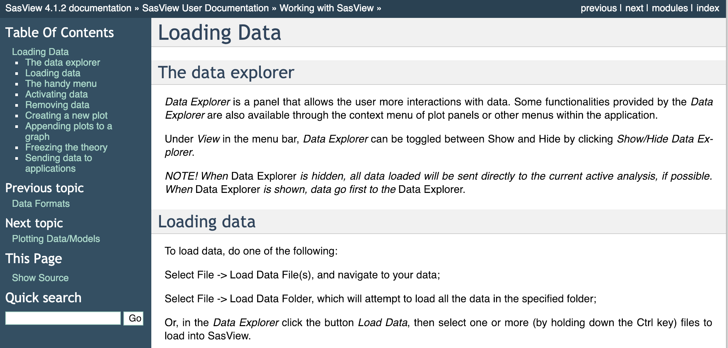
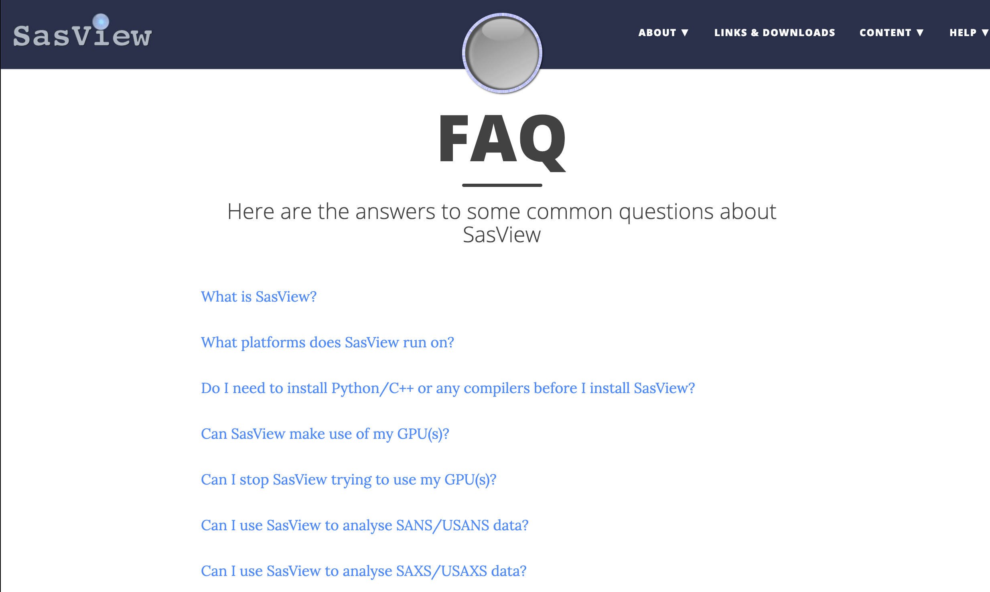
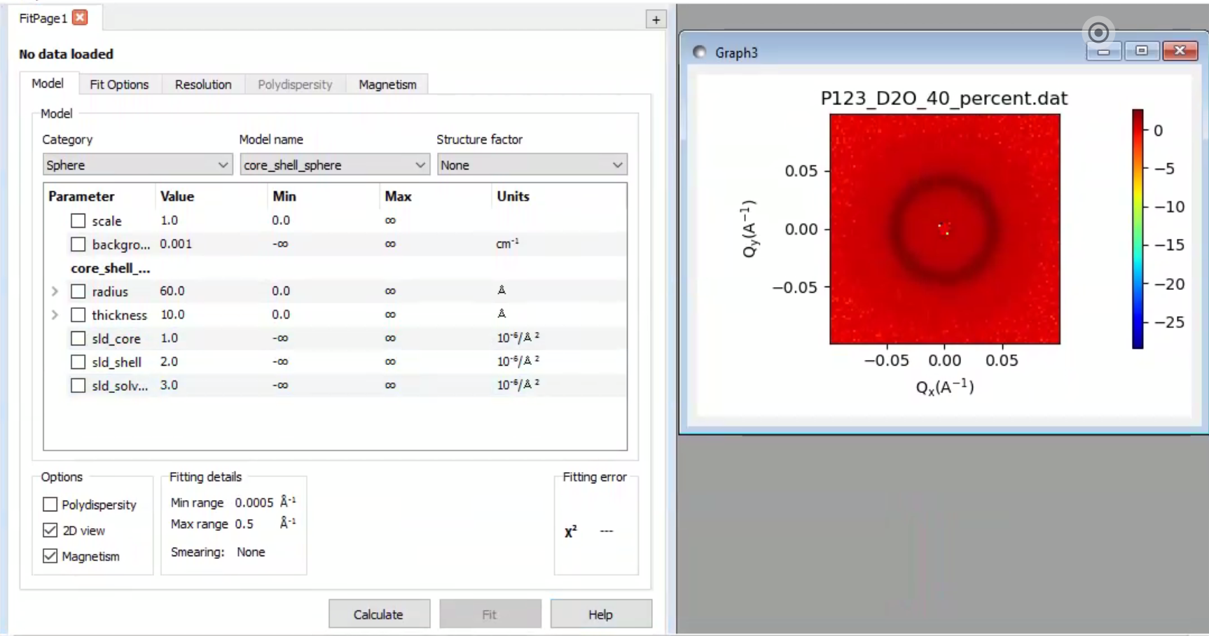
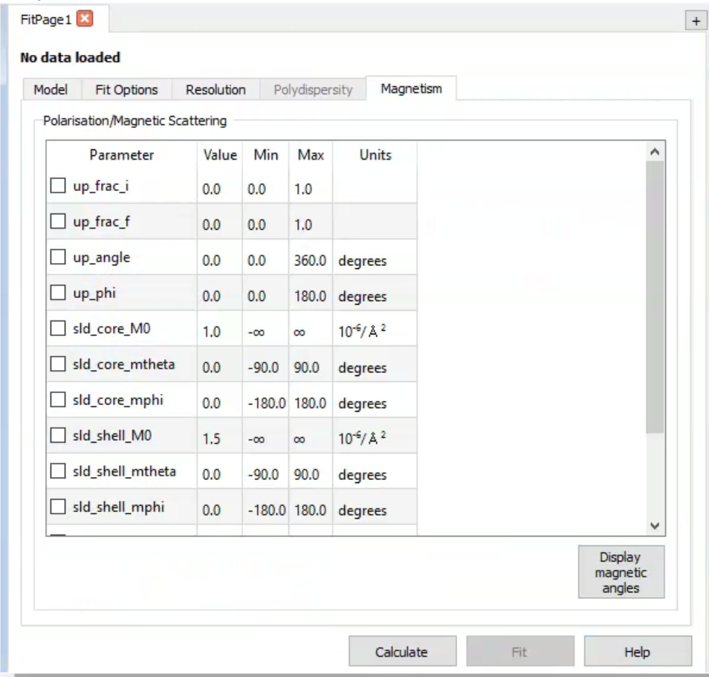
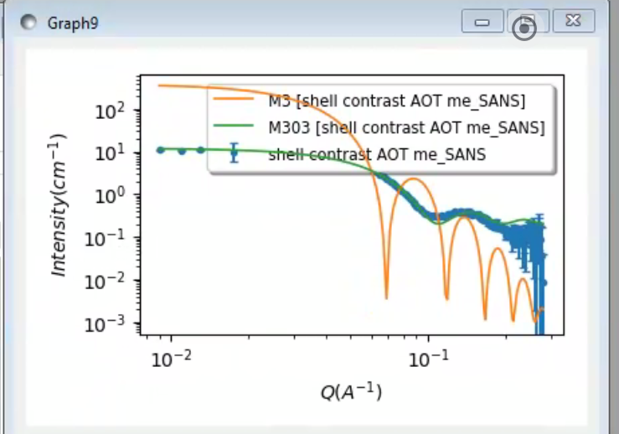
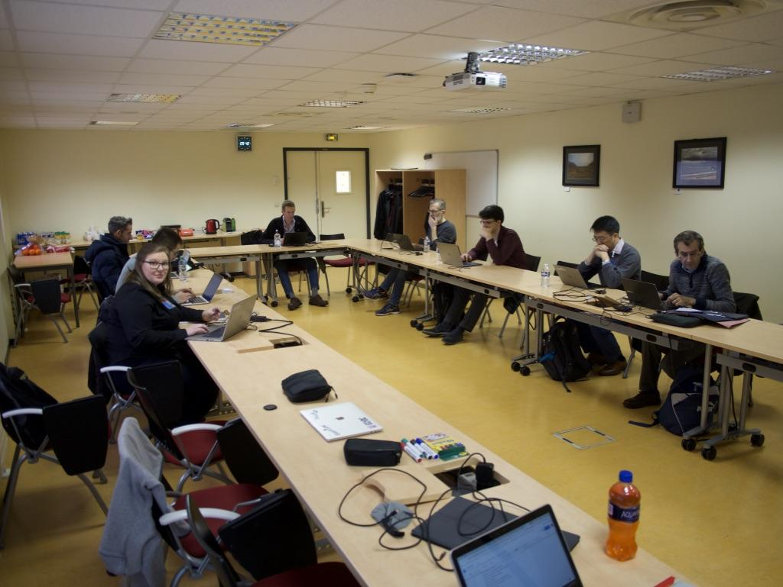
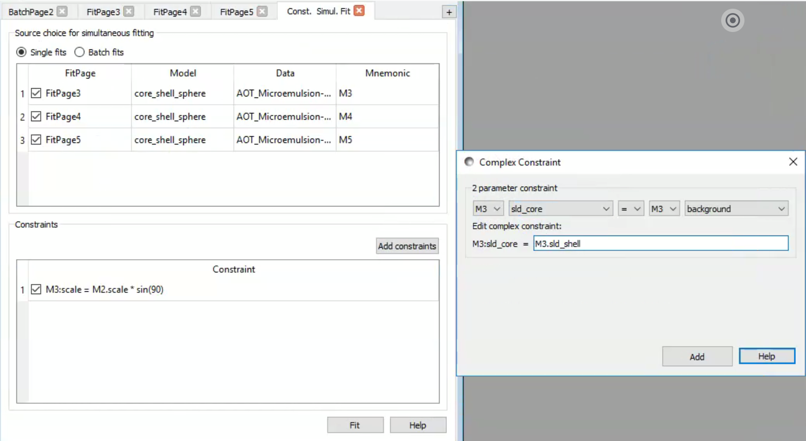
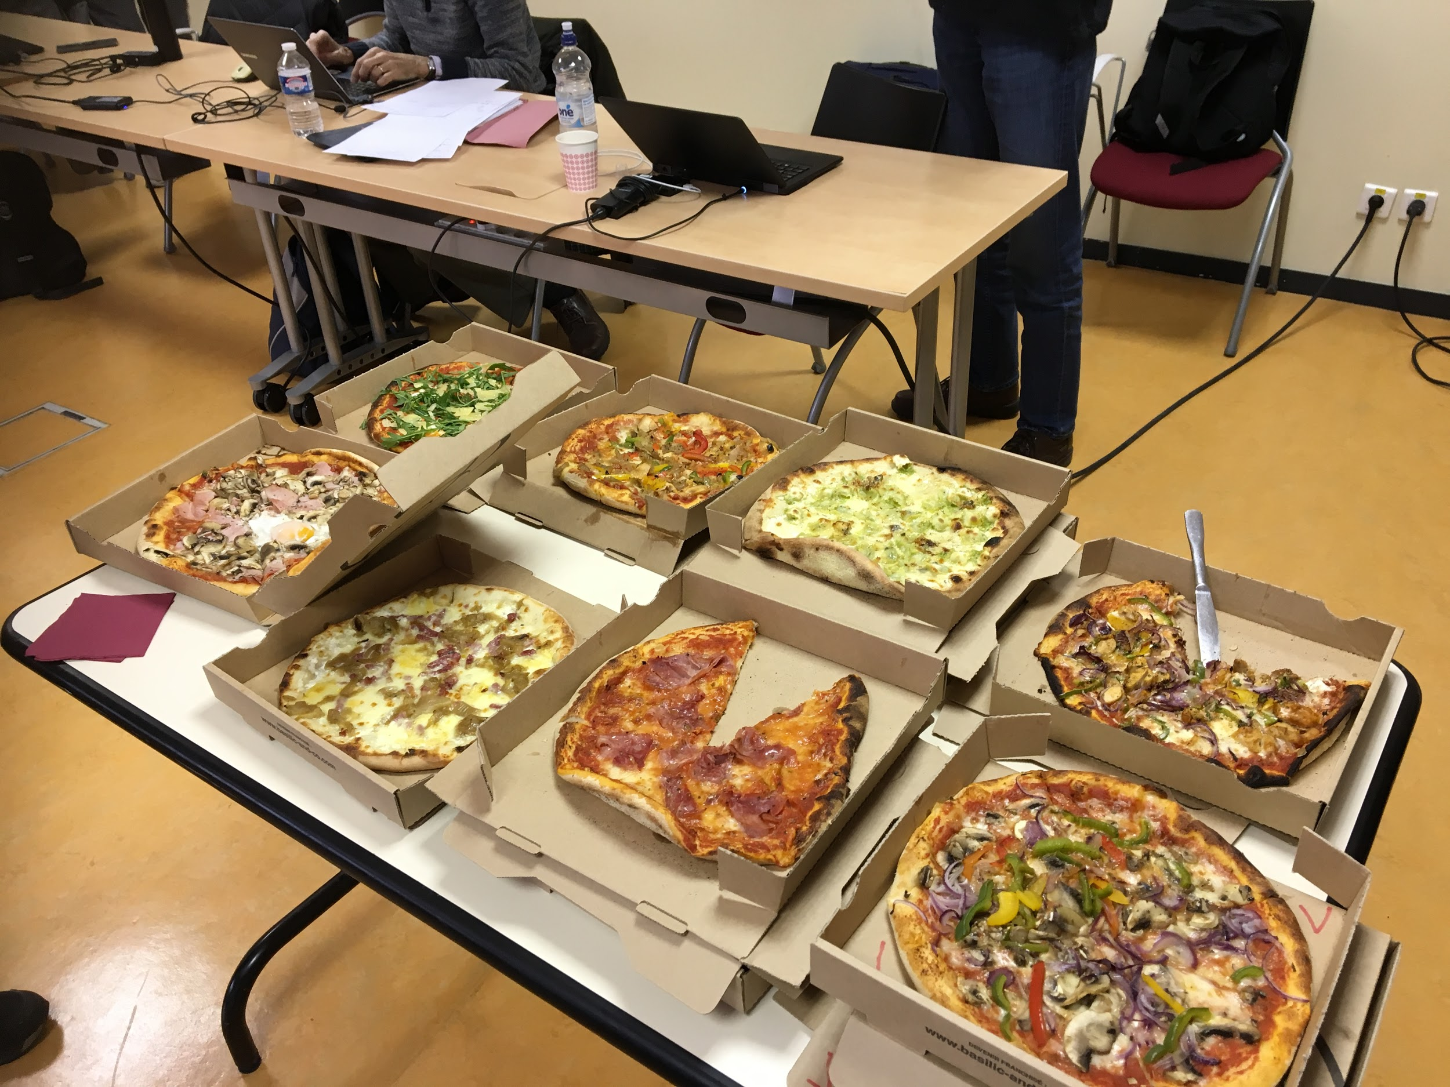
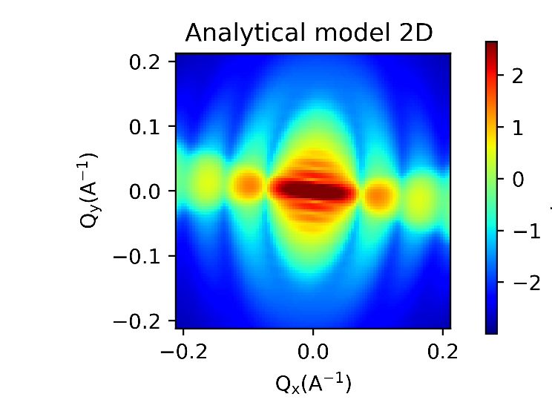
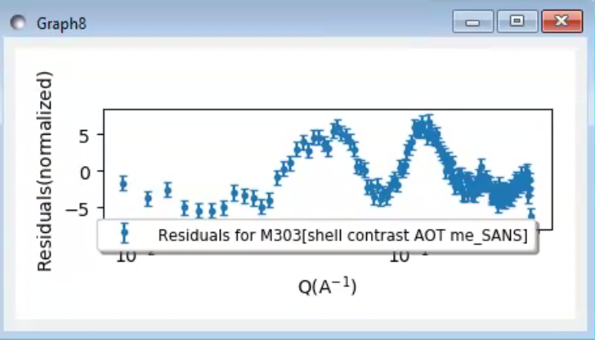
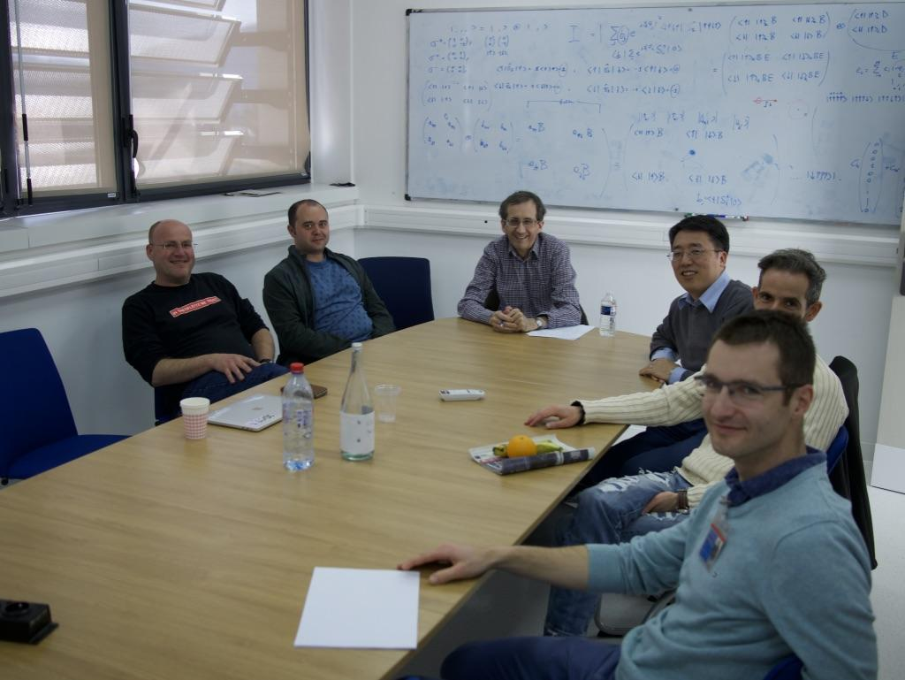
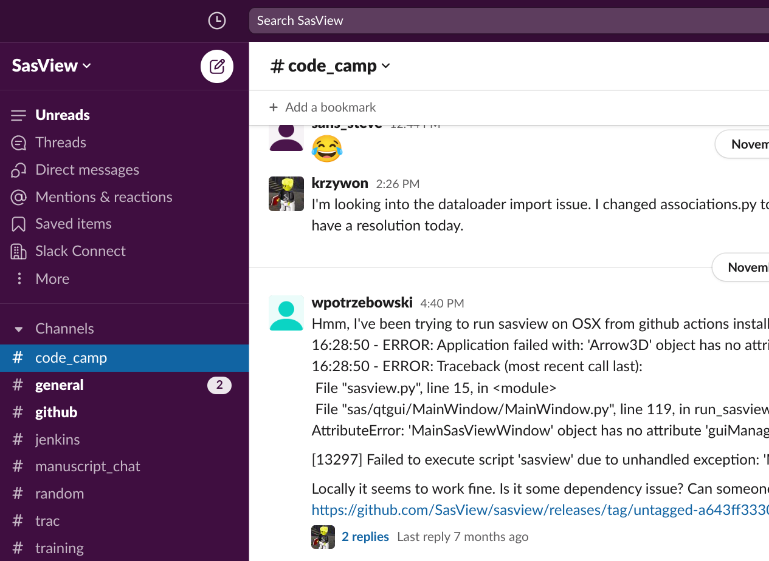
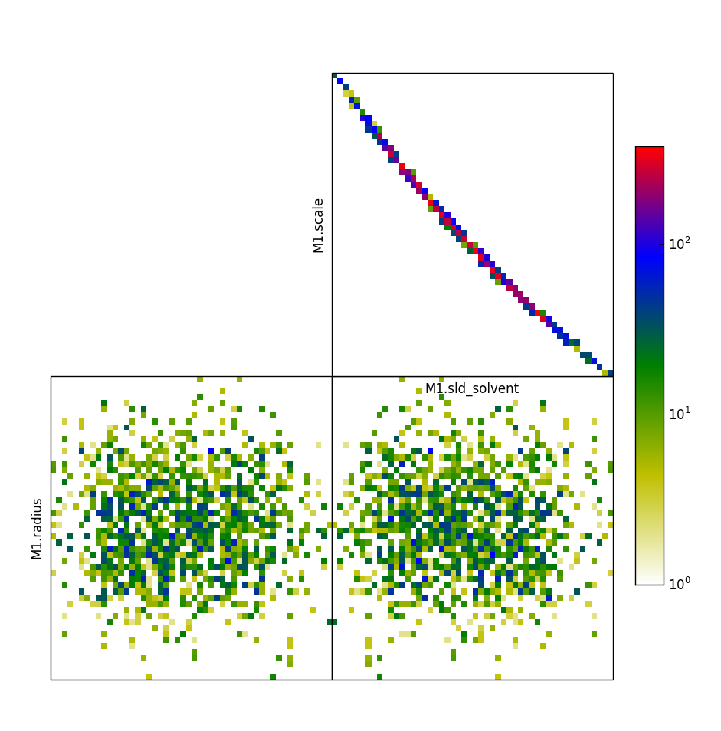
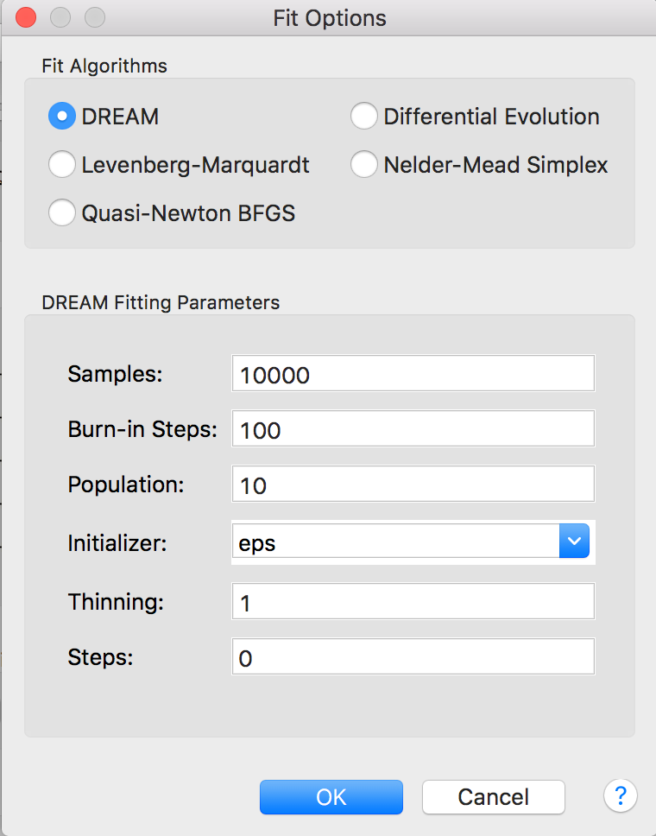
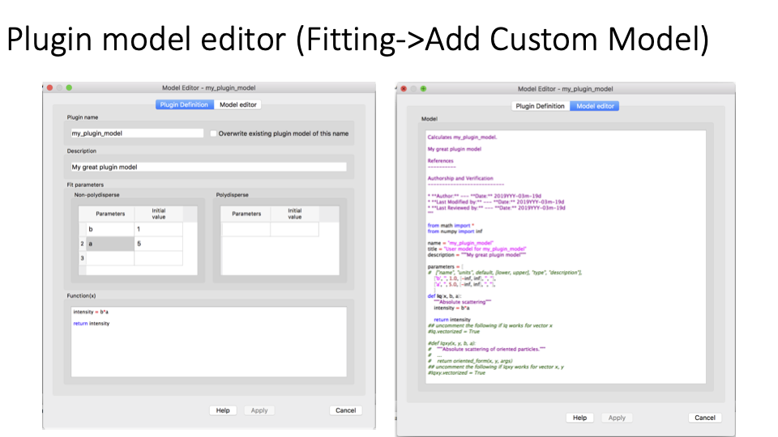
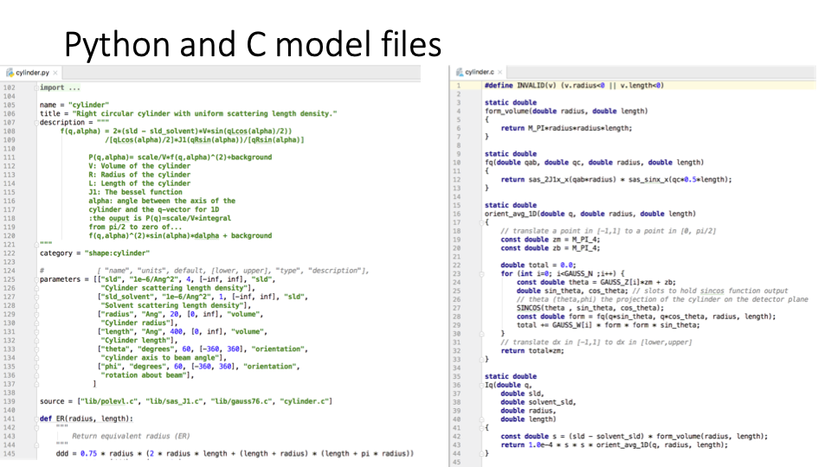
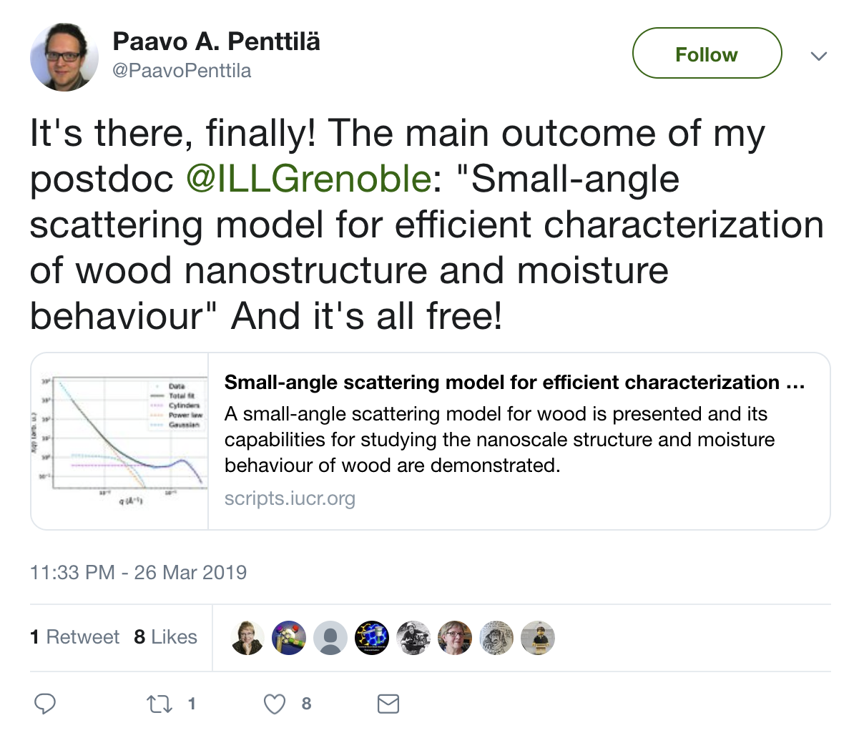
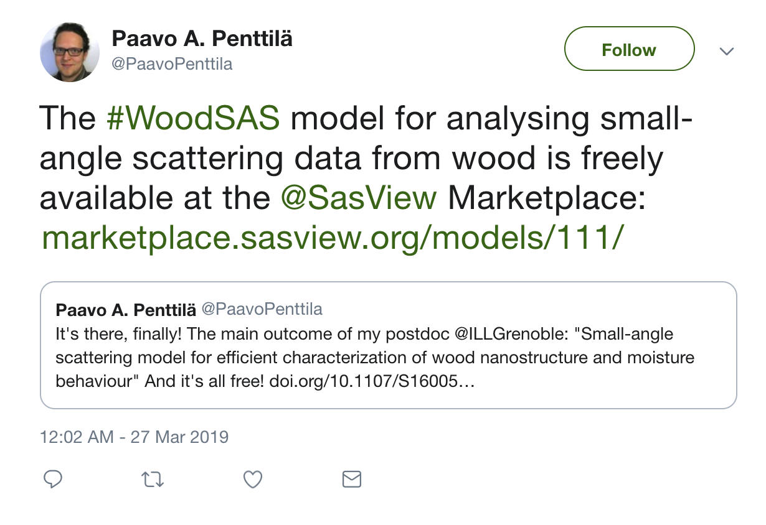
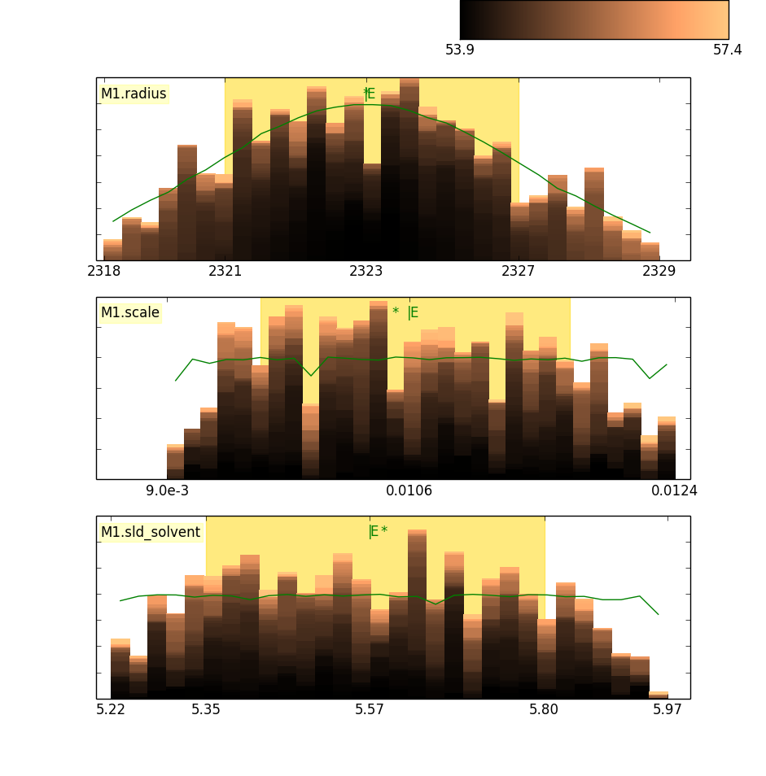
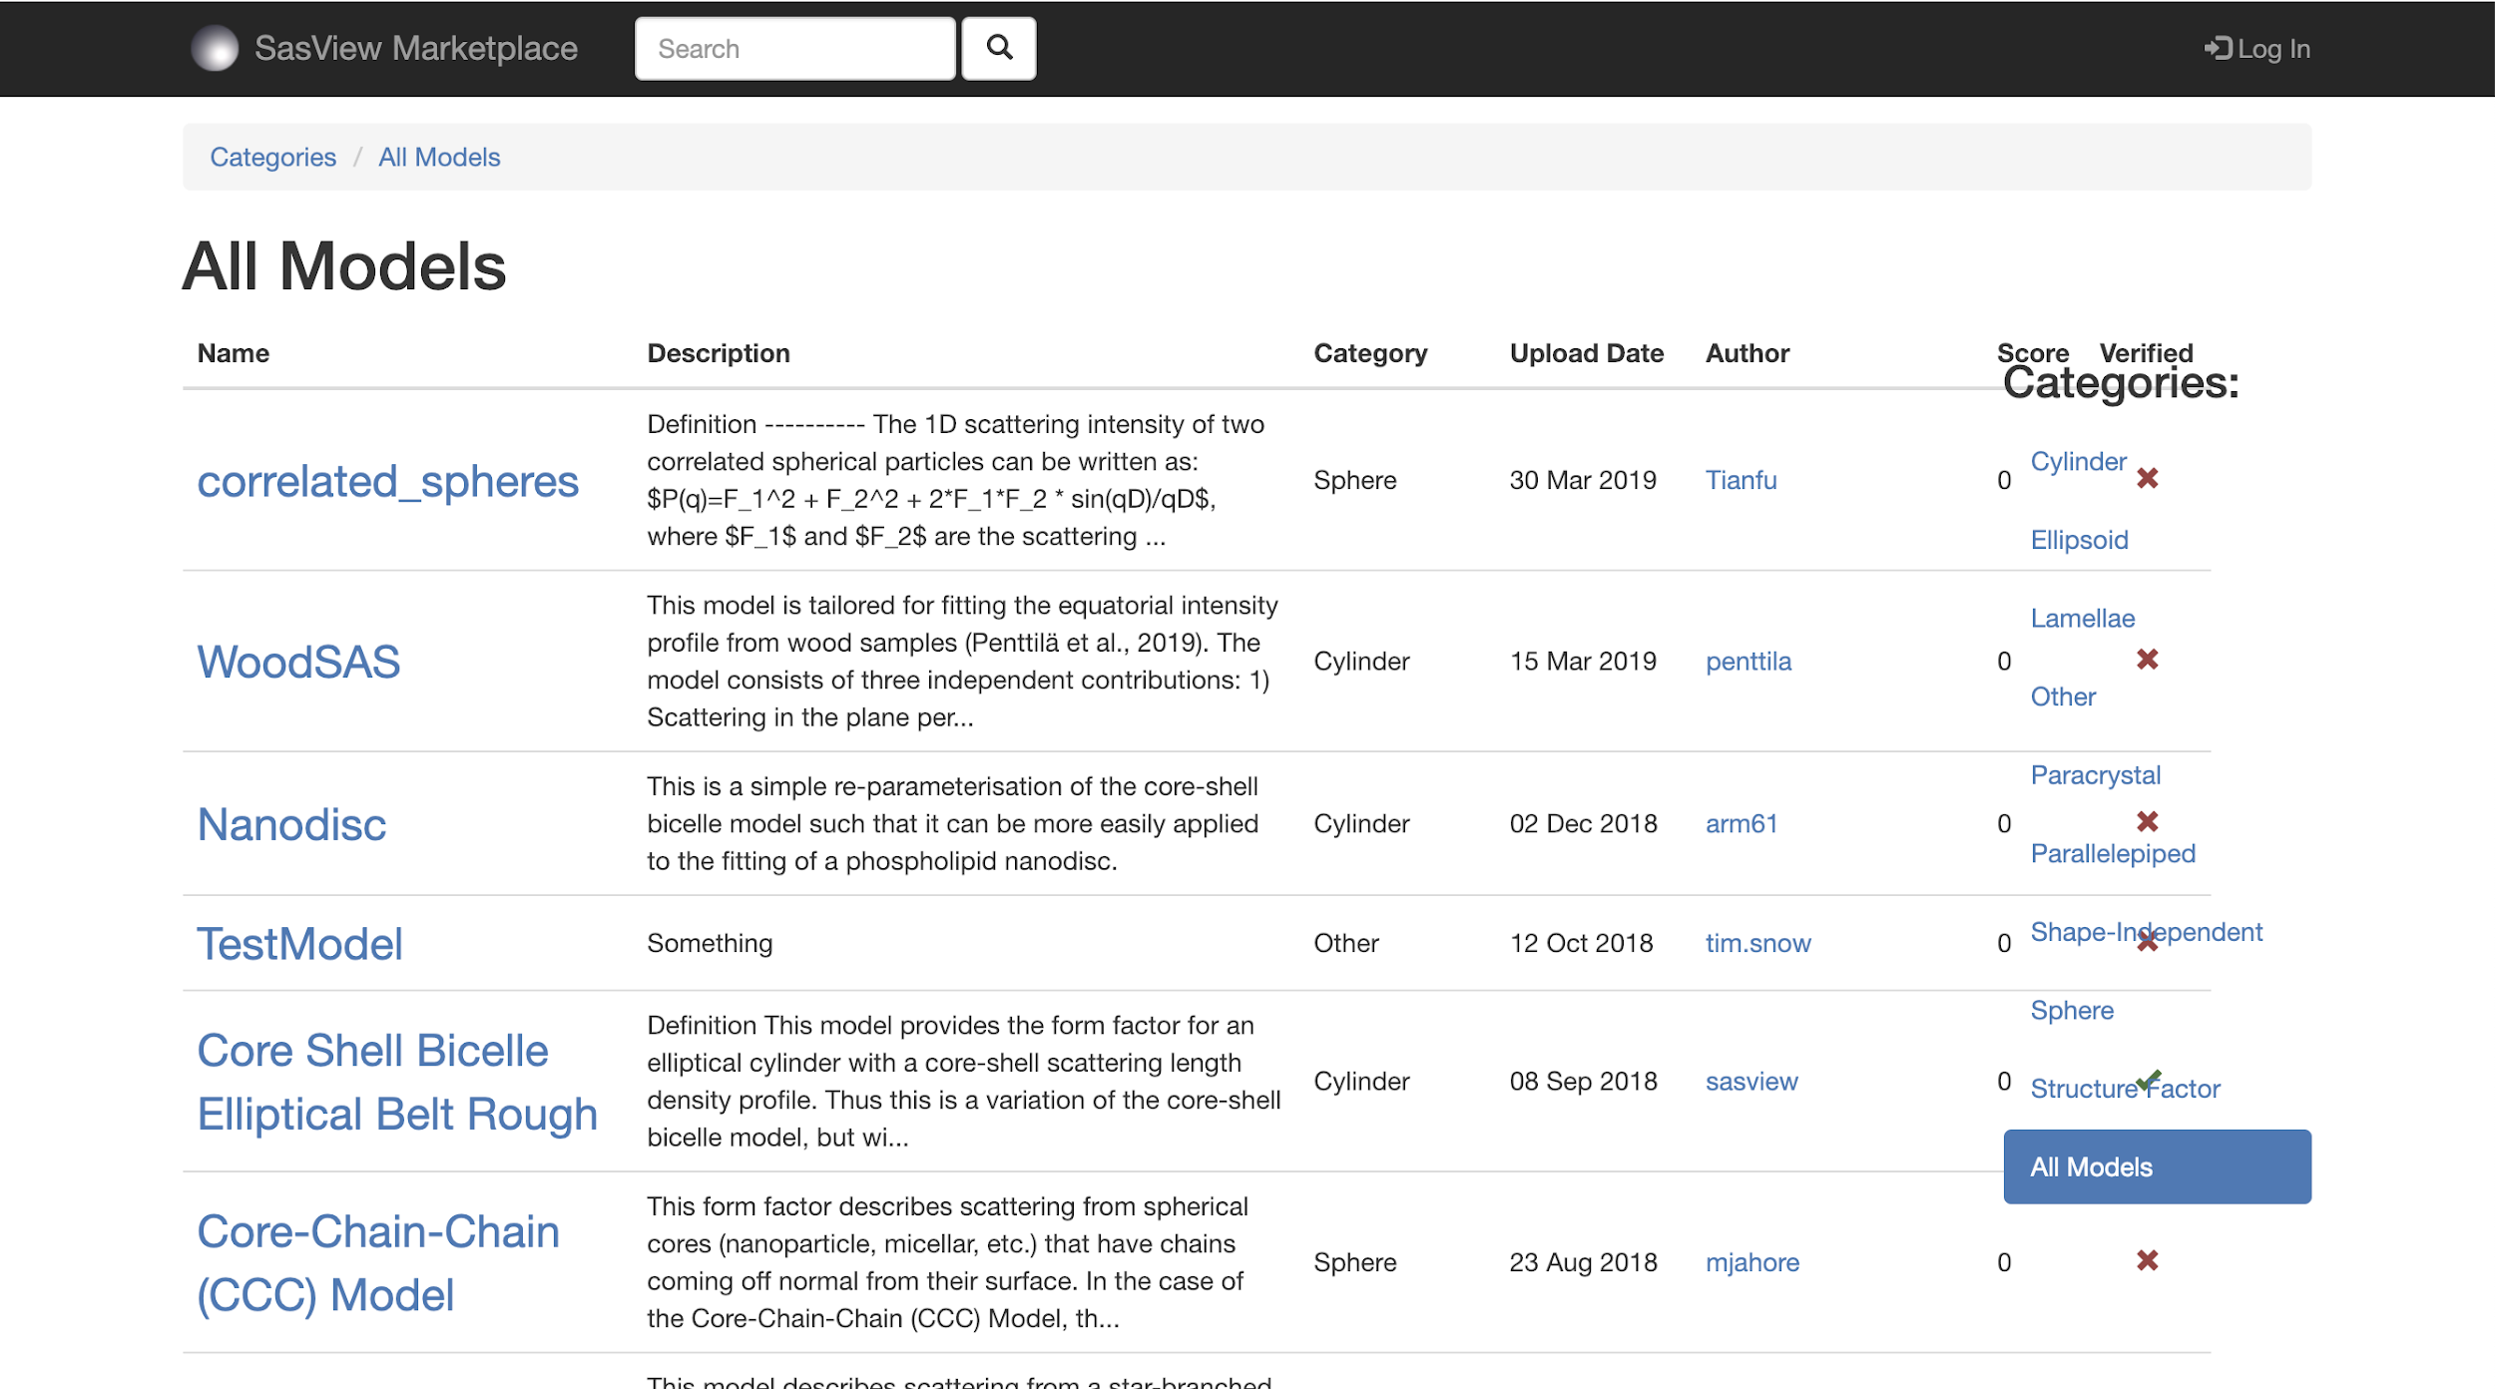
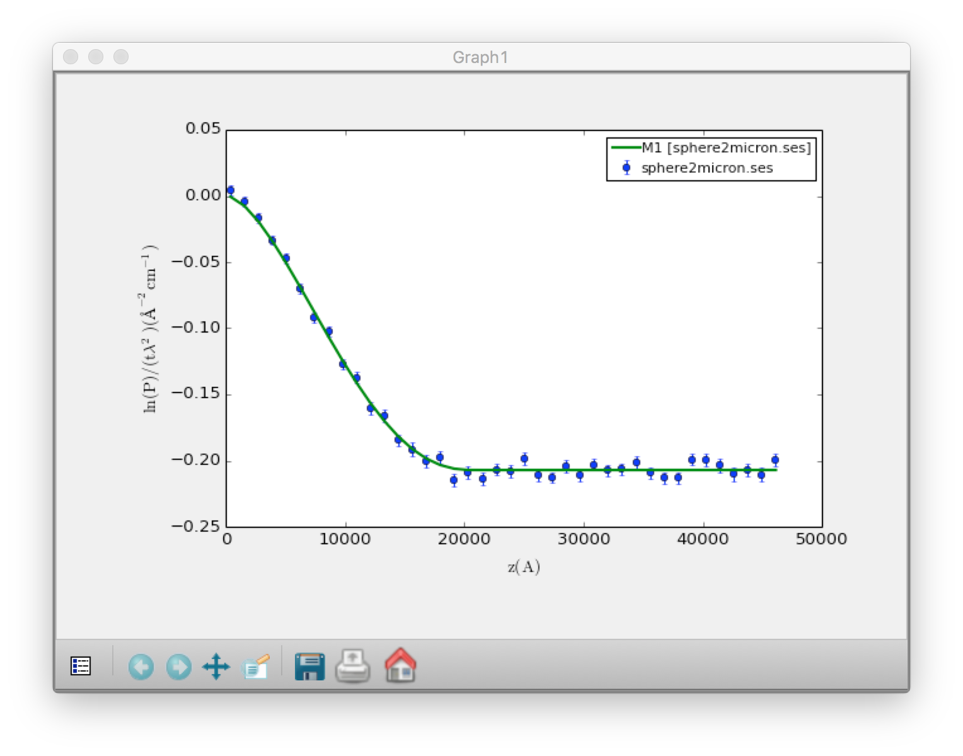
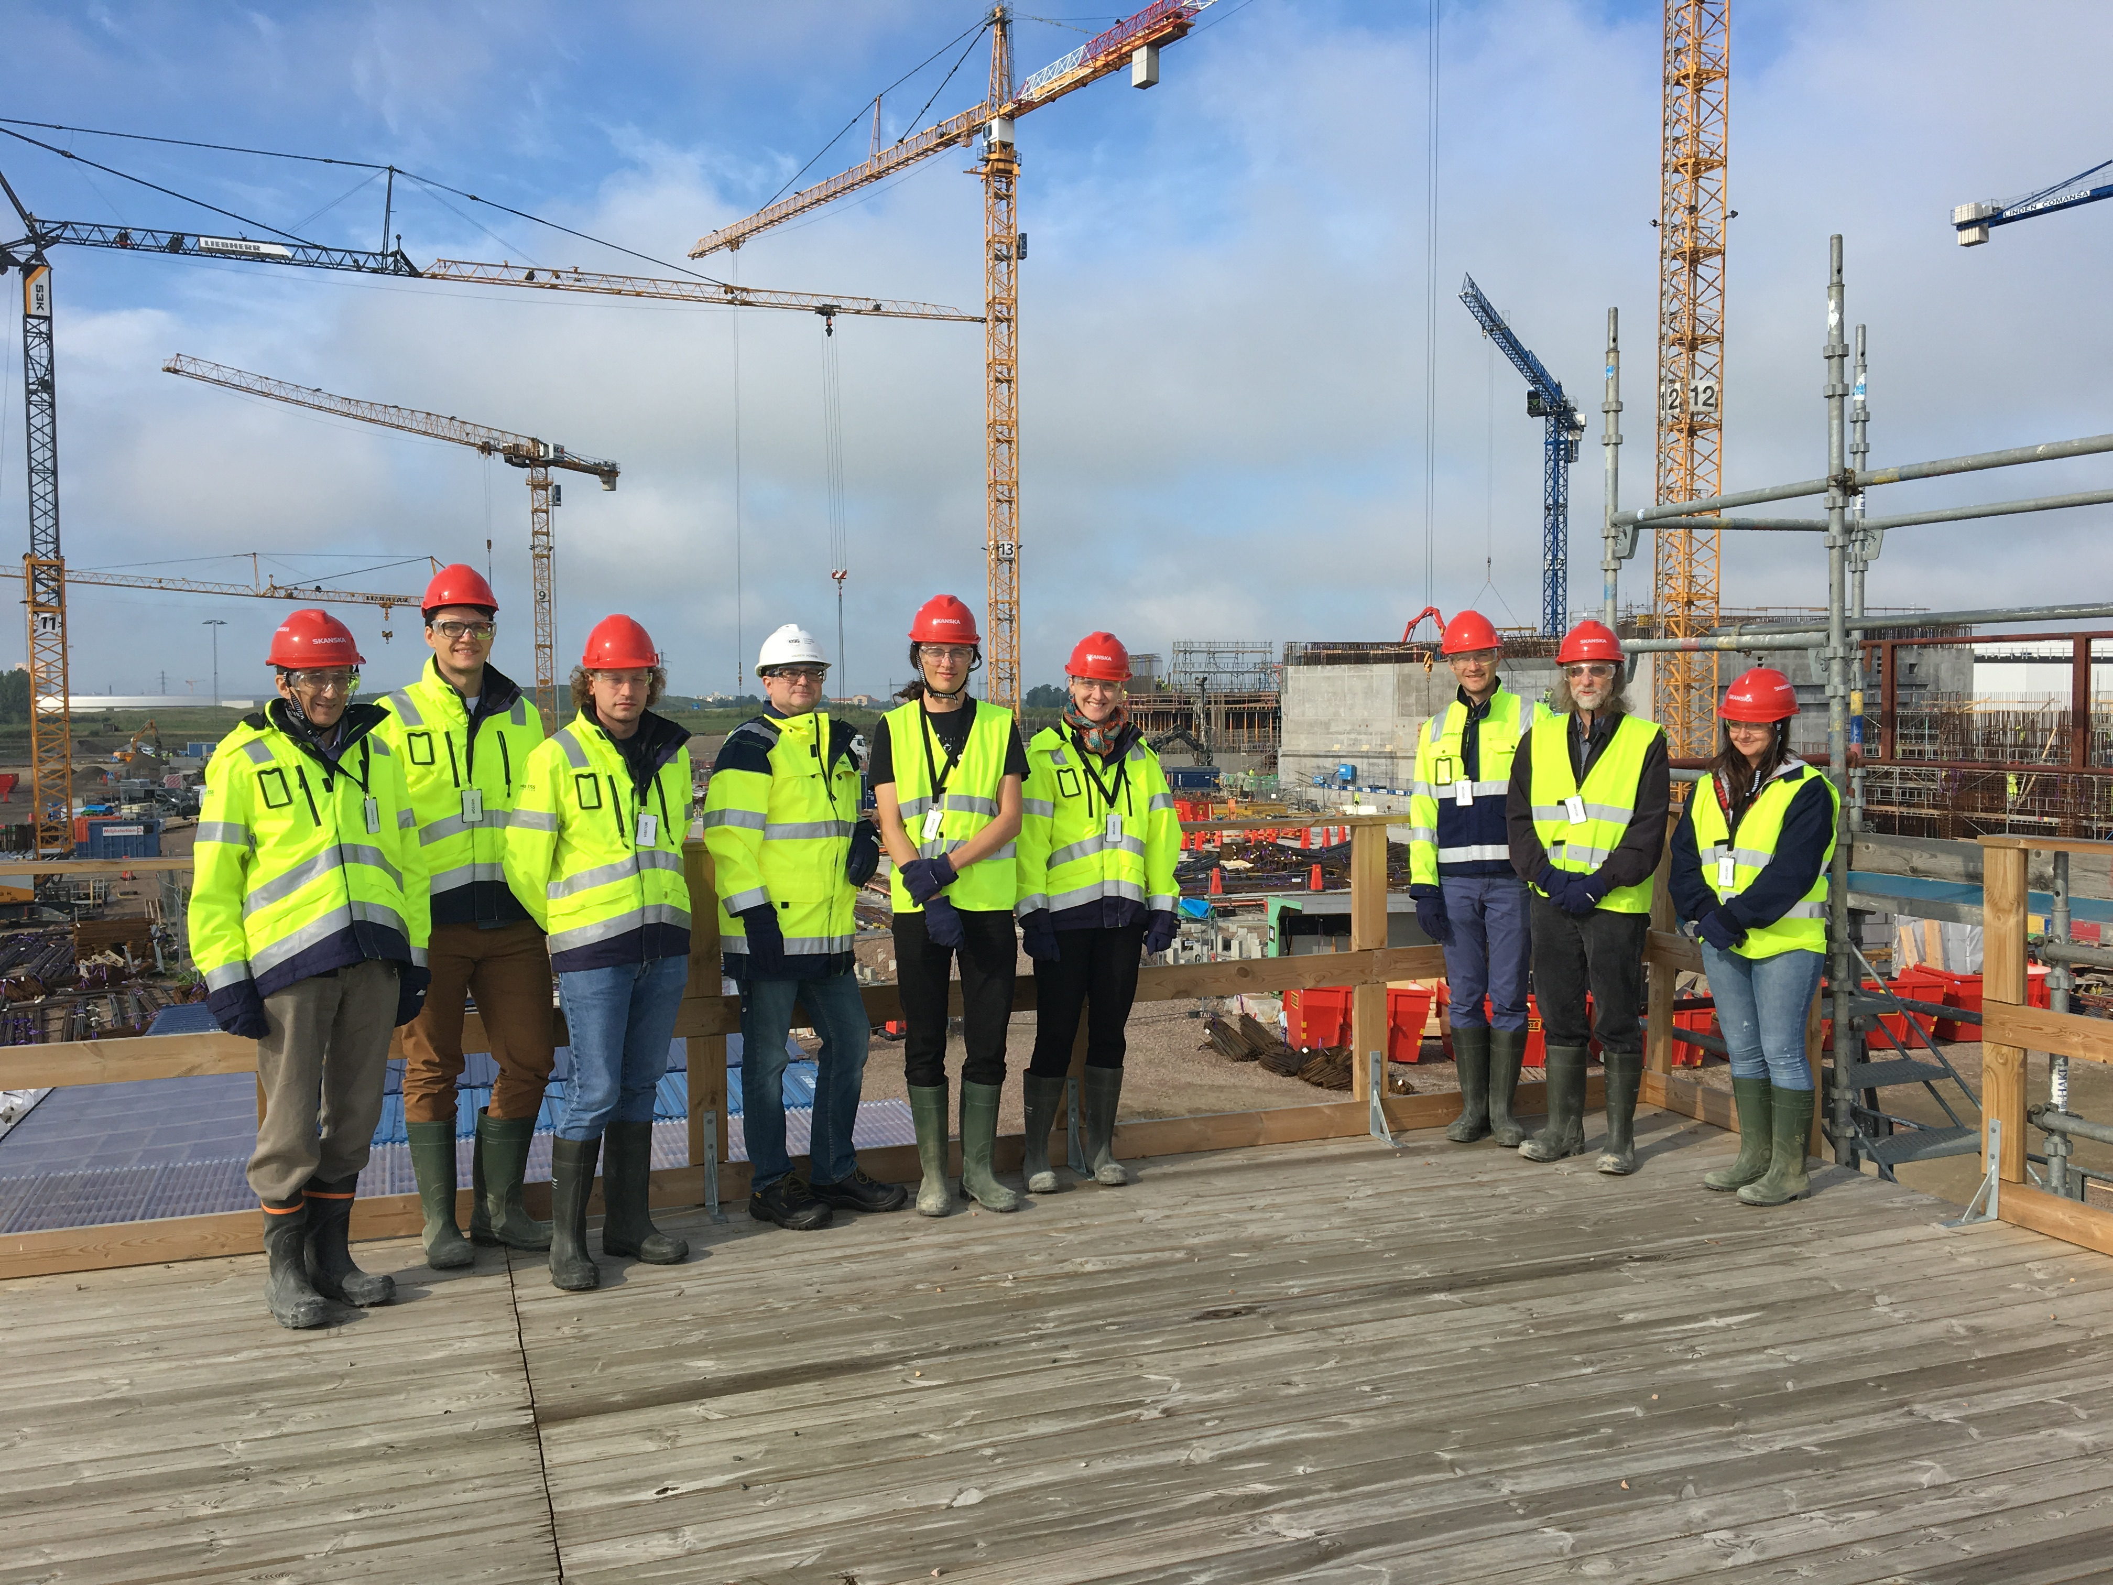
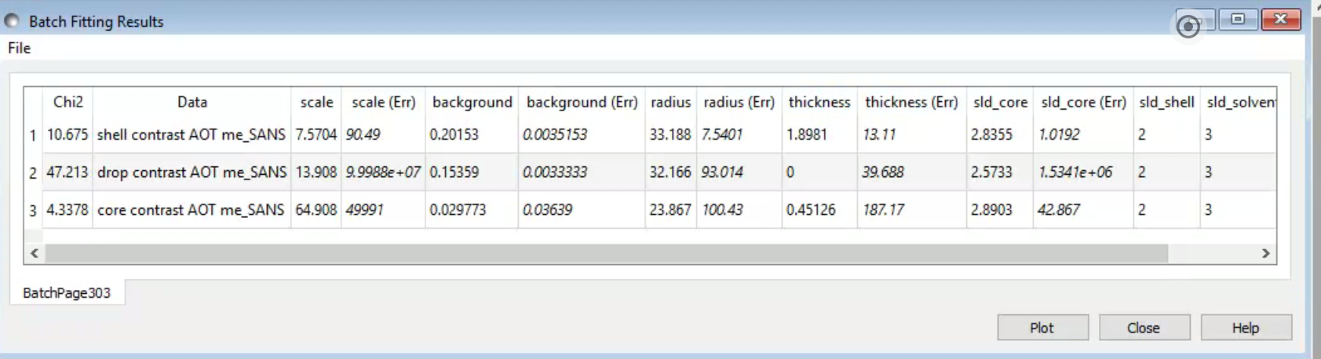
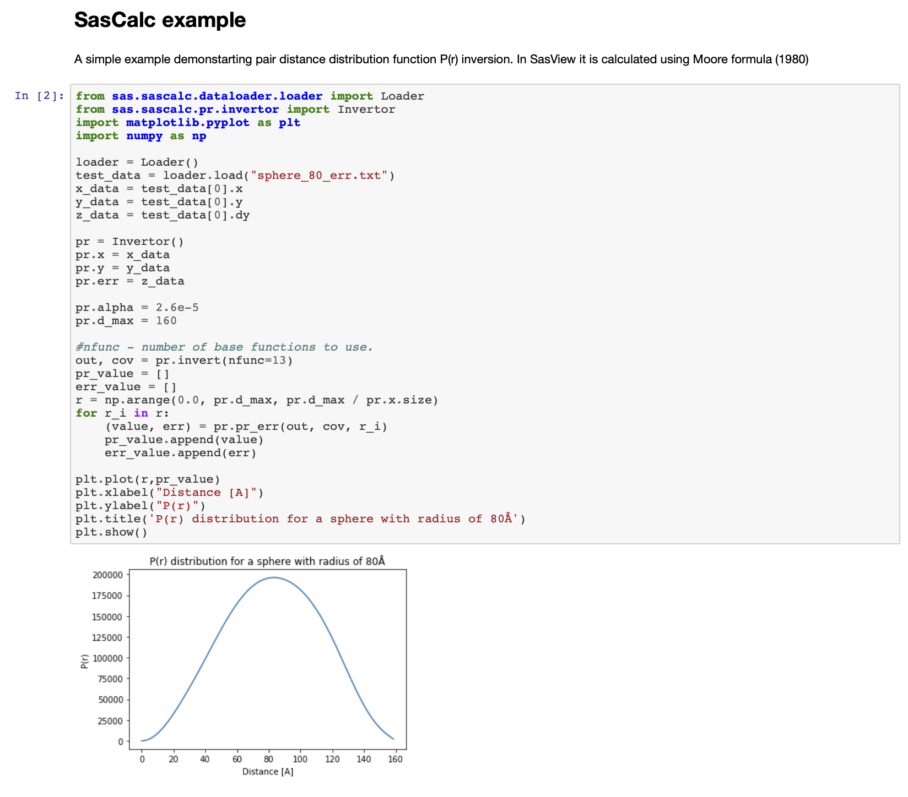
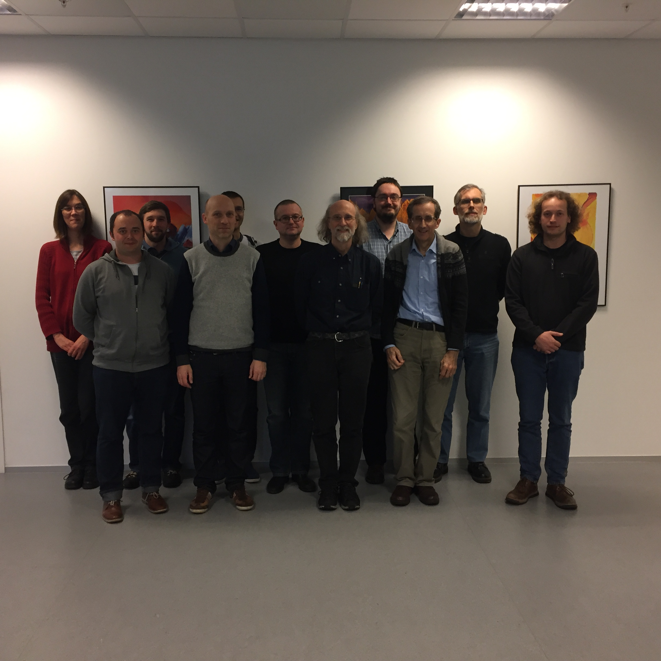
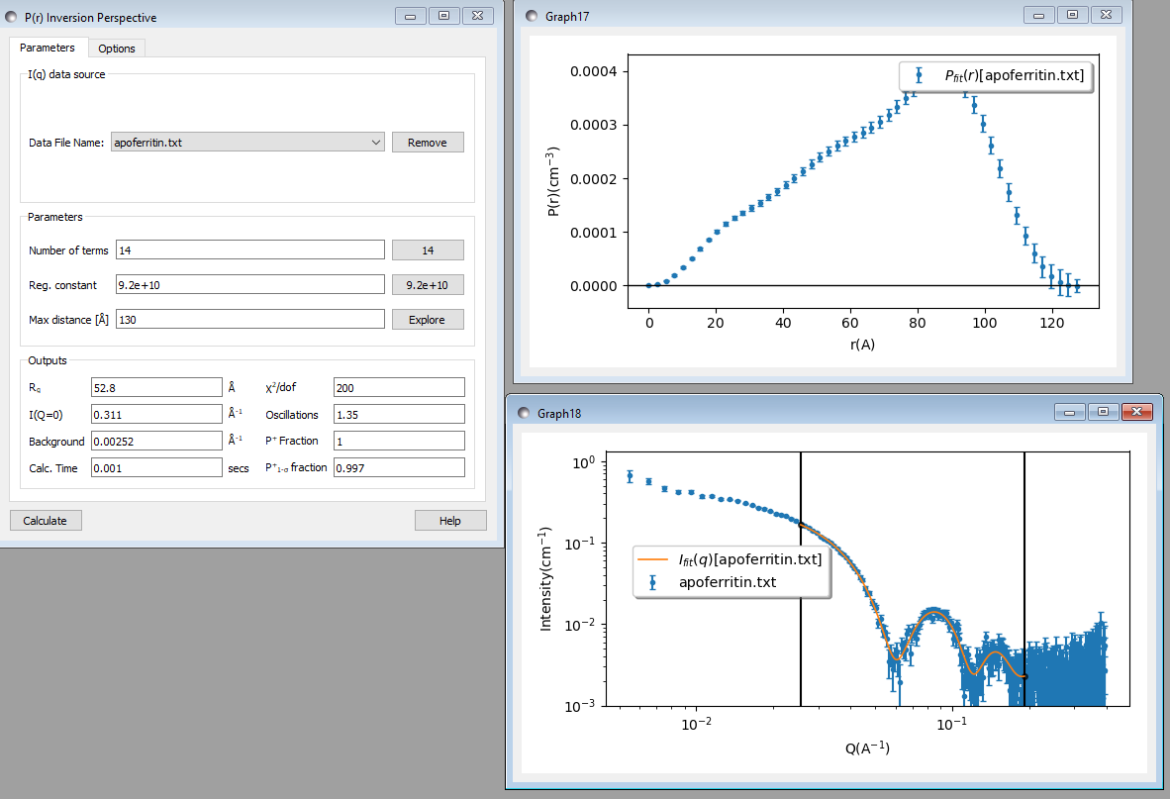
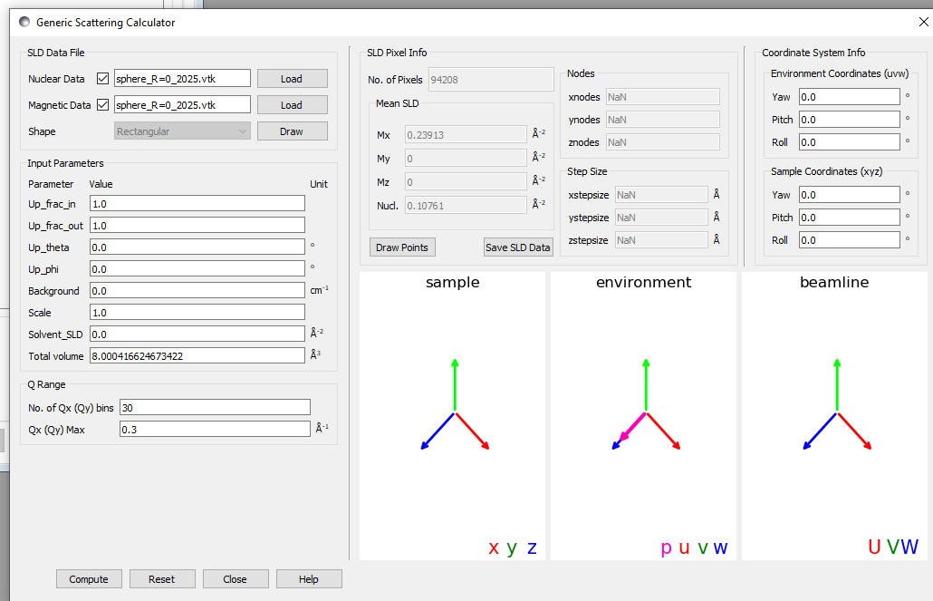
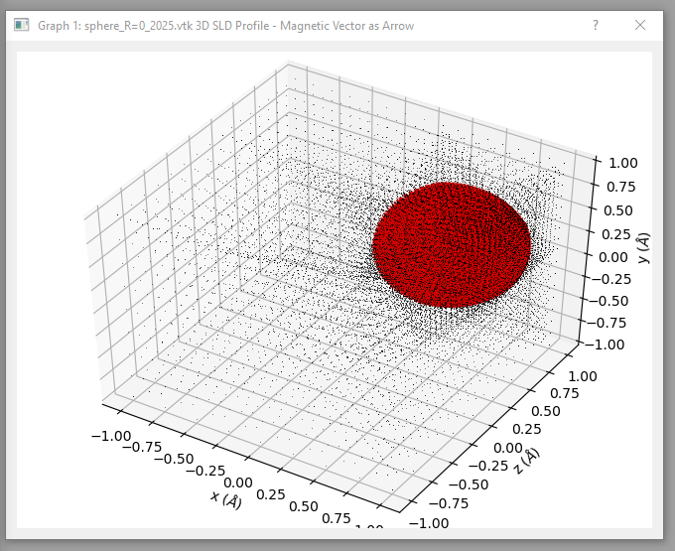
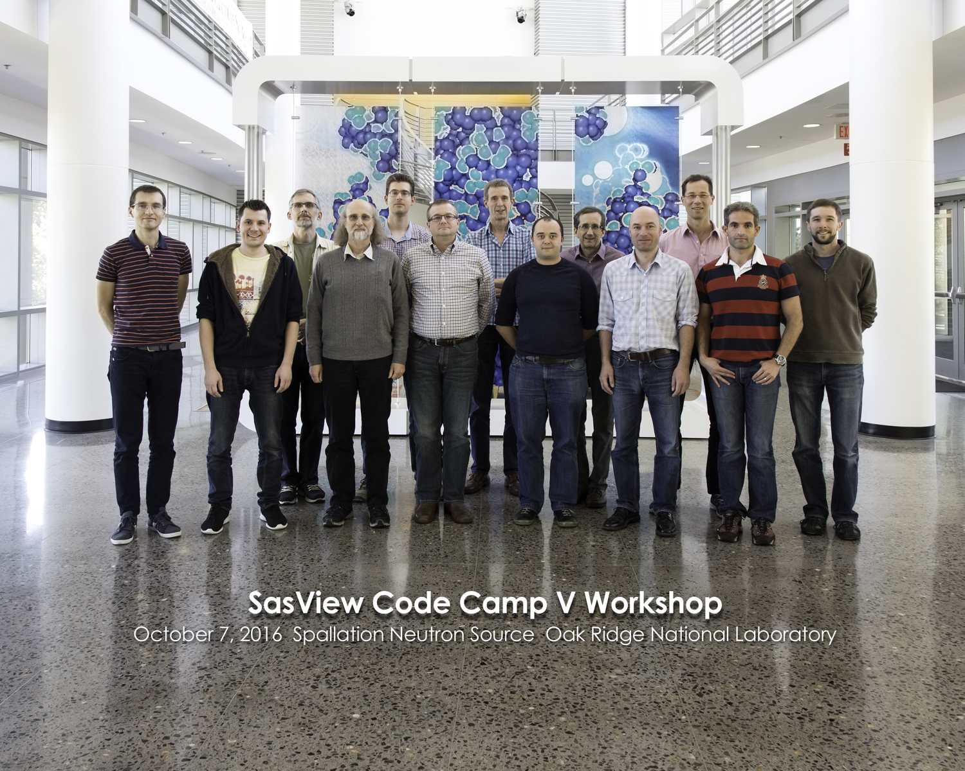
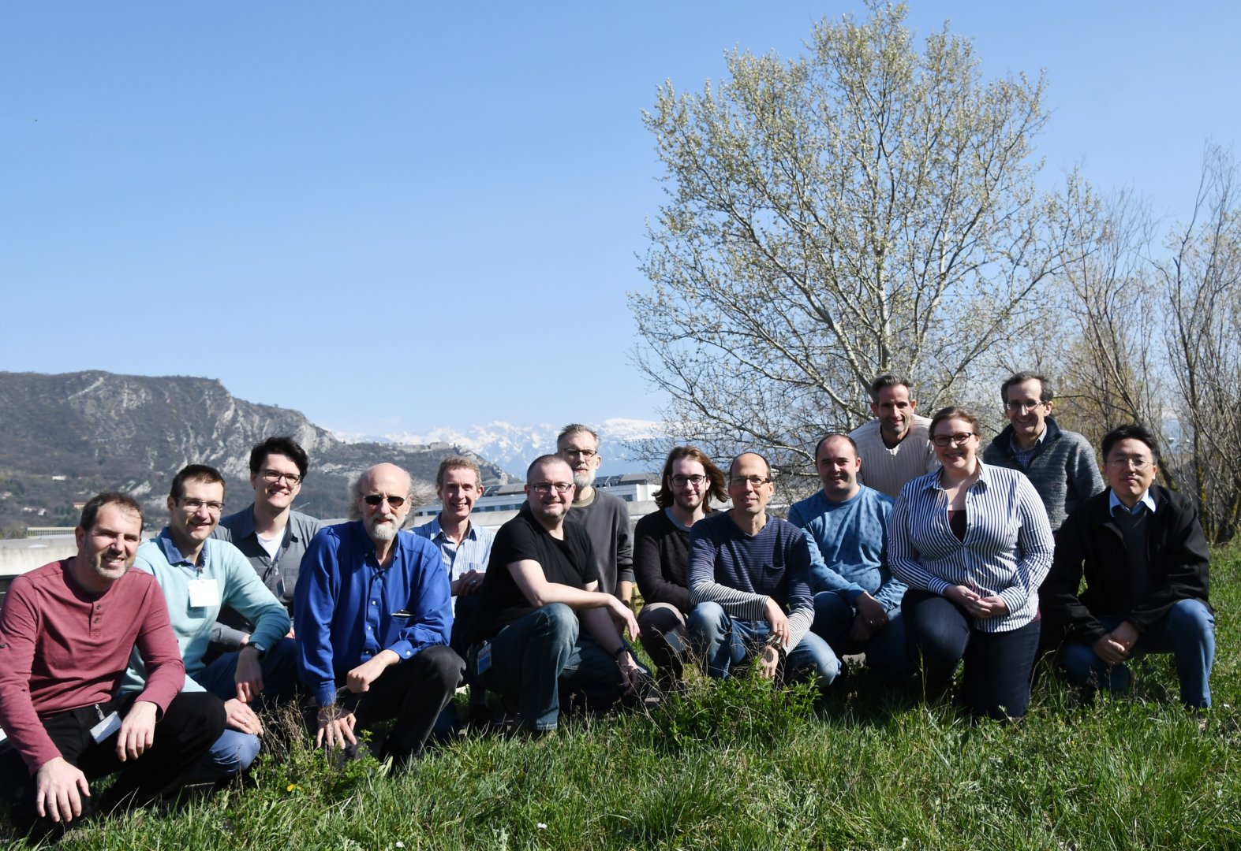


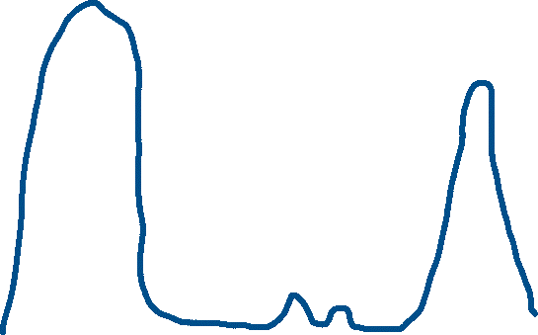
Addressing the resource problem through community:
The SasView Collaboration
Today’s analysis is beyond the skill set of most users
The Problem Statement
The Product/Package
Open, Collaborative, Community Development
Analysis Software - Who’s Job is it Anyway?
Tools
Perspectives on the data
OPEN
Scattering is an analysis tool and part of providing the tool should be the necessary software
→ the FACILITY’S JOB?
Data Operation
SLD calculator
Density/Volume calculator
Slit Size Calculator
Kiessig Thickness Calculator
Q Resolution Estimator
Generic Scattering calculator​
Orientation Viewer​
Python Shell/Editor​
Image Viewer​
File Converter​
Code is open source
publicly hosted at Github
Released under BSD 3-clause license
$$MONEY$$
Analysis is where the science is
→ the USER’S JOB?
Last priority with very limited funding left
Website
Documentation: in-program & online
Written Tutorials
Video Tutorials (YouTube)
scattering schools/workshop
E-learning (starting)
Model Marketplace
Twitter
Bootcamps & regional workshops
Slack
help@sasview.org
users@sasview.org
developers@sasview.org
Source Construction
http://www.sasview.org
Civil Construction
Reduction Sofware
http://github.com/SasView
Data Hardware
Analysis
Software??
Today’s analysis is beyond the skill set of most users
Analysis
Code Hosting, Issue Tracking, Developer Wiki & CI on Public Github repos
Instruments
Fitting
Invariant
Pr Inversion
Correlation Function
Time
Or maybe …..
→ The Domain Science funding agencies?
The Valley(s) of death
Facility directors’ discretion, NIH, NSF, DOE, etc.
1D menu
Slicers and data manipulations
$$MONEY$$
Data Management
2D menu
Special funding (grants) do no fund long term maintenance and ongoing development. They fund “big new (transformative) ideas”
Most all 1D data types supported
Standard data supported (cansas1D and NXcanSAS)
Some image and odd data supported through converters
All data output in NXcanSAS format
Calculated curves associated with data (PQ, SQ, desmeared model, etc)
Project saving capabilities (currently a bit fragile)
Rolling 5 Year Roadmap
(Zenodo) DOI for each release
Time
HOWEVER --- Analysis as defined here is also uniquely universal and ripe for collaborative pooling of finite resources
The unbounded problem
Turning on GPU Option highly recommended for fitting
Fitting Perspective: 1 and 2D Analysis
COLLABORATIVE
Fundamentally all the elements listed in the bar chart are relatively well-defined problems…
A way to focus limited resources on top priorities (most useful to the science being done) in a world of infinite possibilities
A way to harness funding for bold new ideas without losing the investment in the valleys of death
A way to provide sustained maintenance and development in an uncertain funding environment (thriving through the famines)
Magnetic Parameters
Constraints
Twice monthly zoom calls
Regular ‘camps’ & ‘hackathons’
Developer's mailing list
SasView slack
Expertise sharing and helping
Small leadership team to facilitate
EXCEPT ...
Analysis Software is really unbounded. The needs are nearly infinite and constantly evolving.
FACTS OF LIFE:
Resources are finite
Needs are infinite
Orientational polydispersity = “jitter”
Decouples the frame for the object’s orientation with respect to the beam and the “jitter” around the axis of the object.
Collaboration also builds
Community
The SasView approach: vertical and horizontal COLLABORATIONS
Choice of Optimizers
Plugin Model Editor
Python or Python + C
Community
Facilities provide foundational support through participation of data and instrument scientists
Grants and other projects provide “bold new functionality”
Community, writ large, helps provide support and functionality
New ideas tested and developed as before by individuals or larger groups (the community)
Once validated and deemed ready for the larger community these groups provide resources (their labor) to integrate while active developer community helps with training on where things go and on parts of interest to them (collaborative)
Uses bumps package from P. Kienzle
(also has DANSE origins)
Ask not what the community is going to do for you,
ask what you can do for the community
P. Butler, March 2019
No MOU ... all are invited and welcome
Two Basic "Rules"
She who pays the piper chooses the tune
Those who bring the resources (time and effort, or funds to buy time and effort) choose what to work on.
And ...
You cannot break existing experiences ...
New dependencies vs long term maintenance (sustainability)
Code quality vs long term sustainability
Changing/degrading the current user experience for the existing user base
Parameter definition
SESANS Analysis
http://marketplace.sasview.org
Today’s analysis is beyond the skill set of most users
Automatic Hankel Transform of SANS models (TU Delft & ISIS)
Model calculation
History and Status of SasView
2006; originates in NSF DANSE project
2013; transitions into a community project
2016; Sine2020 project funded
2022; Essentially a “volunteer army”
--------------------
~40 contributors from 9 organizations so far (~10-15 active at any one time)
1 to 2 releases/year (5.0.6 JUST RELEASED)
Documentation/tutorial projects ongoing
Usage? Seems to be "everywhere?"
Publications? > 100/year
Batch Fitting
Original put together by an SIS Summer Student Lewis O’Driscoll
Jupyter Notebooks
And Command Line
Today’s analysis is beyond the skill set of most users
SasView Model: Some Current Challenges
Generic Scattering Calculator
The price of success:
The tragedy of the commons: somebody else will take care of the problem.
Hard to get non-coders to believe they can contribute equally – it is unfortunately in the name “code camp” … words matter → Contributor camp?
Building community, especially during a pandemic is HARD WORK
Lack of funds for small things … but beware too much money?
Hard to keep up with increasing security issues with these resources so far.
P(R) Perspective
Many people view the project as a well-funded group of professionals → barrier to contribution – e.g: Old website and no graphics = not serious; Nice graphic slick website = professional → way beyond my skills – how to navigate?
Large project with many moving pieces is a barrier to new volunteer coders
Heavily geared towards colloid science
NEW: Magnetic SANS effort

